Slide 1
CORPUS
Mukund Nuthi
Balaram Remala
Pavan Teja Reddy Duggempudi
Under the guidence of :
Dr. Somya Mohanty

Slide 2
About the Dataset
Amazon Product Reviews Dataset
The Database and Information Systems Laboratory at The University of Illinois at Urbana-Champaign.
Six categories (camera, mobile, TV, laptop, tablet, and video surveillance system).
Currently we are working on Mobile, Laptops and Tablets.
Our data is in JSON format and has 1 JSON file for each product.

Slide 3
Data Cleaning
Filtering Stop-Words and punctuations in the reviews.
Split Attached Words.
Removal of URLs.
Stemming.

Slide 4
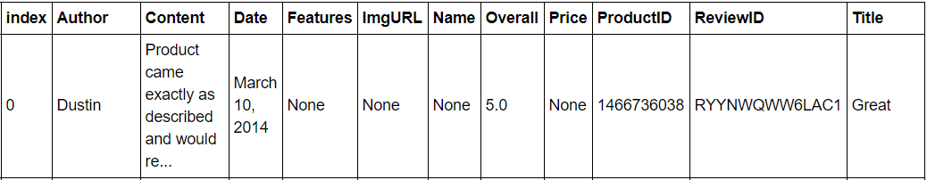
Building a Complete Dataset
A complete dataset was built by combining thousands of JSON files.
Using “to_pickle()” function the complete dataset was saved to pandas dataframe for future use.

Slide 5
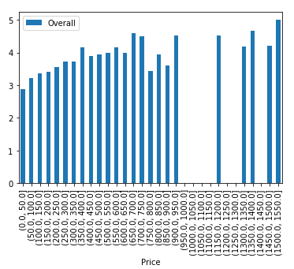
Analyzing the Ratings based on Price Range.
Ignoring all the null values, Mean rating for each product is found.
Next created Price Ranges for all similar products.
Analyzed the ratings based on Price Range.
Concludes that Price is not affecting the Rating.

Slide 6
Text Analytics
Filled out the missing text for a product based on the review content (like Product Name, Make).
Classifying the reviews as positive and negative for a particular product.
Best Features for the product.

Slide 7
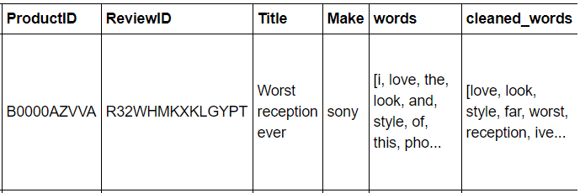
Cleaning the Text Data by removing stopwords
Cleaning the text is the most important part of text analytics.
Here is the snapshot of our data after cleaning the stopwords and punctuations.
A new column ‘make’ is added, which is extracted from Product name using regex.

Slide 8
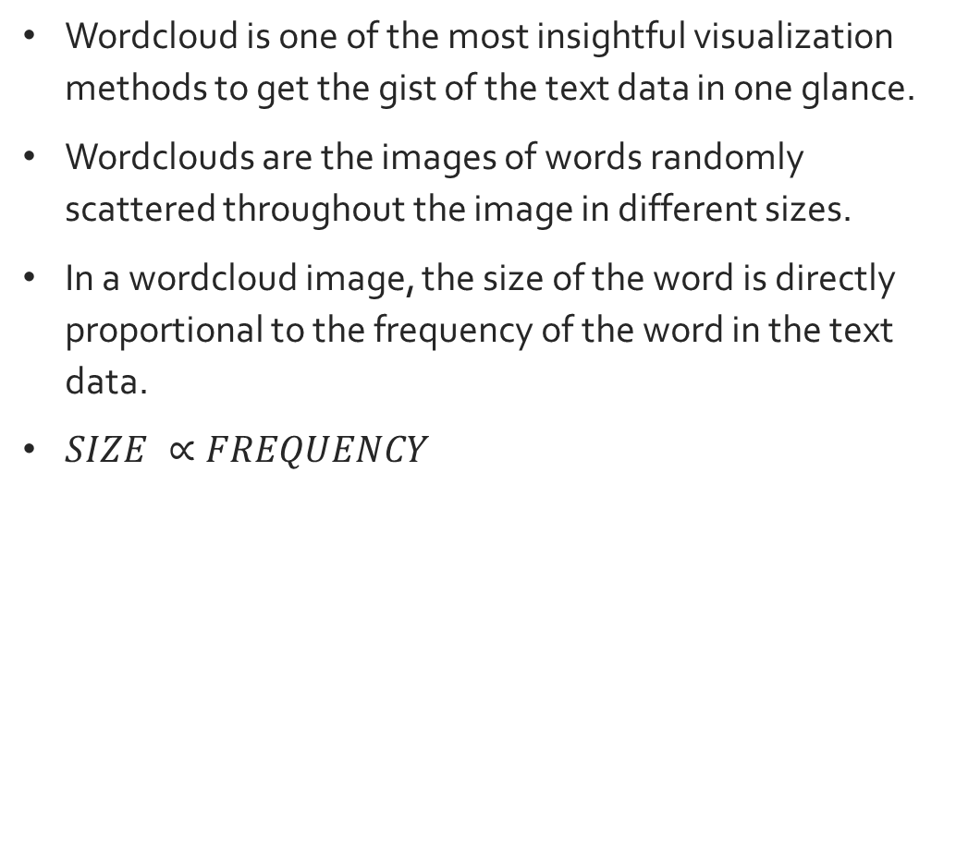
WordClouds
Wordcloud is one of the most insightful visualization methods to get the gist of the text data in one glance.
Wordclouds are the images of words randomly scattered throughout the image in different sizes.
In a wordcloud image, the size of the word is directly proportional to the frequency of the word in the text data.
$SIZE ∝FREQUENCY$

Slide 9
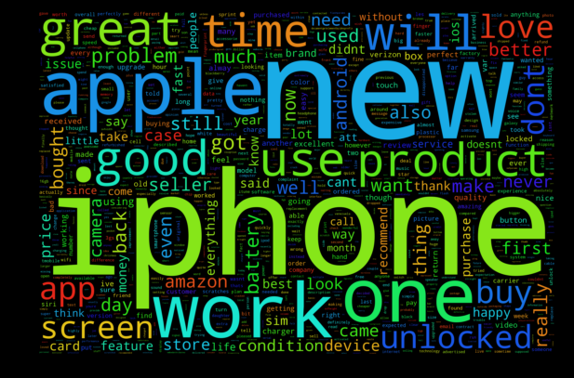
WordClouds at Make level
WORDCLOUD for the make ‘APPLE’

Slide 10
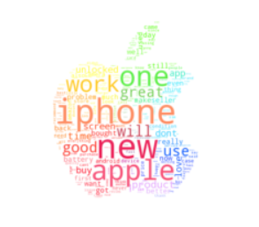

When WordCloud gets FANCY
FANCY WORDCLOUD FOR THE MAKE ‘APPLE’
Picture showing the wordcloud masked in the form of Apple logo along with the colors.

Slide 11
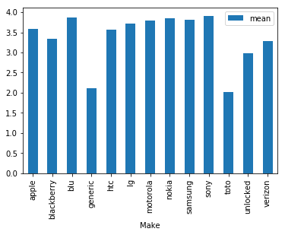
Plot for Make vs Ratings
This is the plot for Make vs Avg. Ratings.
Mean of all the ratings and the number of ratings are considered in this plot.

Slide 12
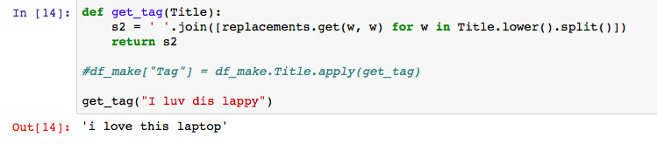

Converting short words/ abbreviations to full words
It is necessary to convert the slang words/abbreviations like luv, haven’t, didn’t etc. to full words so that the classifier can detect the content accurately.
Here is the sample:

Slide 13
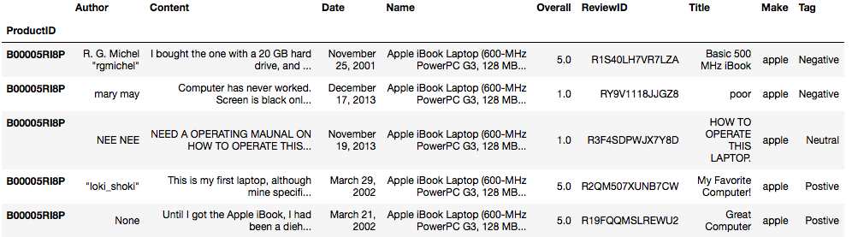
Classification of Reviews to Positive/Negative/Neutral
The reviews are classified based on the content of each review.
This is achieved based polarity and subjectivity of text which is decided by NaïveBayesClassifier.
The NaïveBayesClassifier is trained with set of positive, negative and neutral words.

Slide 14
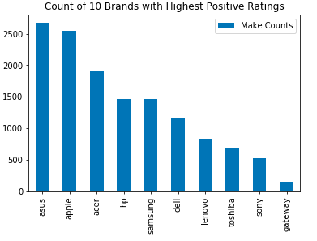
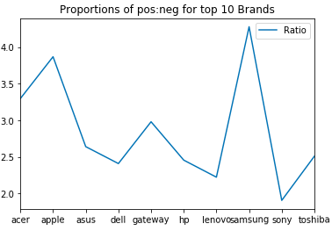
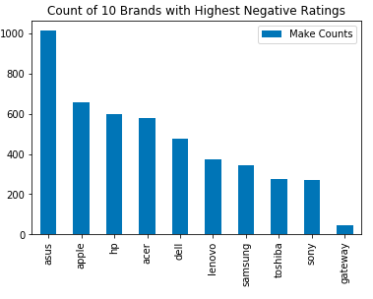
Analysis on “Tag” for Laptops Dataset

Slide 15
QUESTIONS?!

